Slide 1
Model Construction
Data Normalization & Input Preparation
LSTM with VADER news sentiment
LSTM with FinBERT news sentiment
Financial News Data
Financial Data
Comparison & Evaluation
Predict Close Price
Hyperparameter Tuning
- Metrics: RMSE, MAPE, R-squared
- Statistical Testing

Slide 2
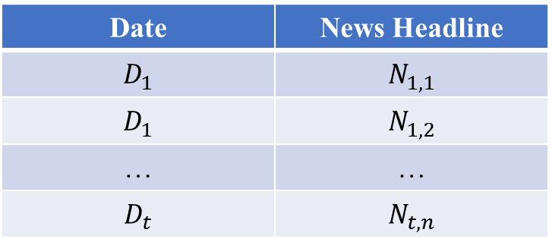
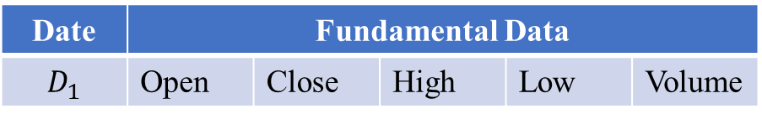
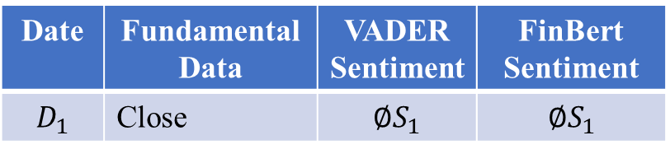
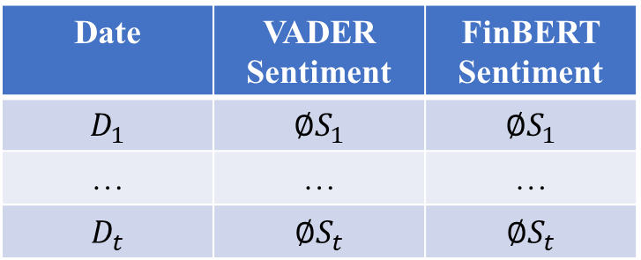
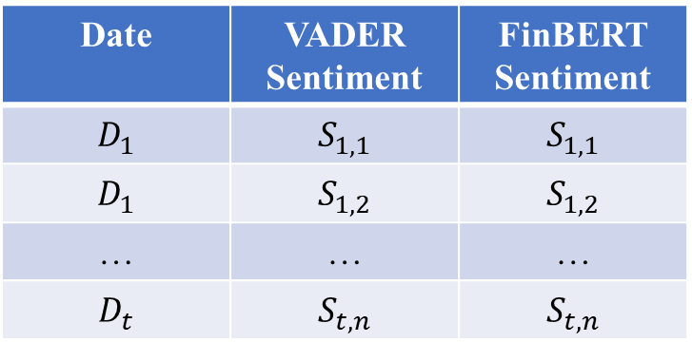
Numerical Data
Textual Data
Date | Fundamental Data
$$D_{1}$$ | Open | Close | High | Low | Volume
Date | News Headline
$$D_{1}$$ | $$N_{1,1}$$
$$D_{1}$$ | $$N_{1,2}$$
… | …
$$D_{t}$$ | $$N_{t,n}$$
Sentiment Analyzer
Date | VADER Sentiment | FinBERT Sentiment
$$D_{1}$$ | $$S_{1,1}$$ | $$S_{1,1}$$
$$D_{1}$$ | $$S_{1,2}$$ | $$S_{1,2}$$
… | … | …
$$D_{t}$$ | $$S_{t,n}$$ | $$S_{t,n}$$
Average Sentiment
Date | VADER Sentiment | FinBERT Sentiment
$$D_{1}$$ | $$∅S_{1}$$ | $$∅S_{1}$$
… | … | …
$$D_{t}$$ | $$∅S_{t}$$ | $$∅S_{t}$$
+
Date | Fundamental Data | VADER Sentiment | FinBert Sentiment
$$D_{1}$$ | Close | $$∅S_{1}$$ | $$∅S_{1}$$

Slide 3
Input Layer
LSTM
Dropout
LSTM
Dropout
Output Layer

Slide 4
Previous Data
Next Day’s Closing Price
Previous Closing Prices
Previous Sentiment Scores

Slide 5
Historical Data
Predict Closing Price N+1

